Slide 1

Cognitive Computing
Dr. Piyush Joshi
Assistant Professor
IIIT Sri City

Slide 2
Our unique brain capabilities: Motion
Precision throwing: no other animal can do that even they have visual motion detection capabilities.
Avoid/catch animal by looking their motion
Facial expressions are incredibly subtle and we can detect fleeting expressions.
Direction of motion

Slide 3
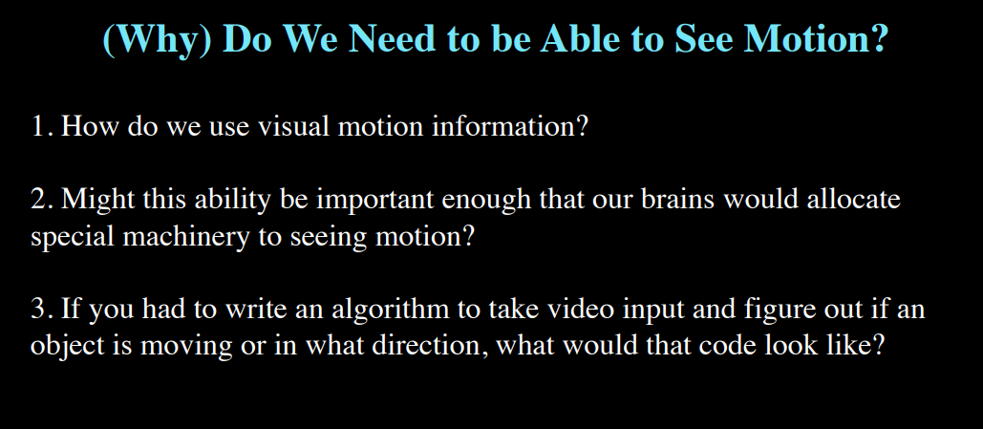

Slide 4
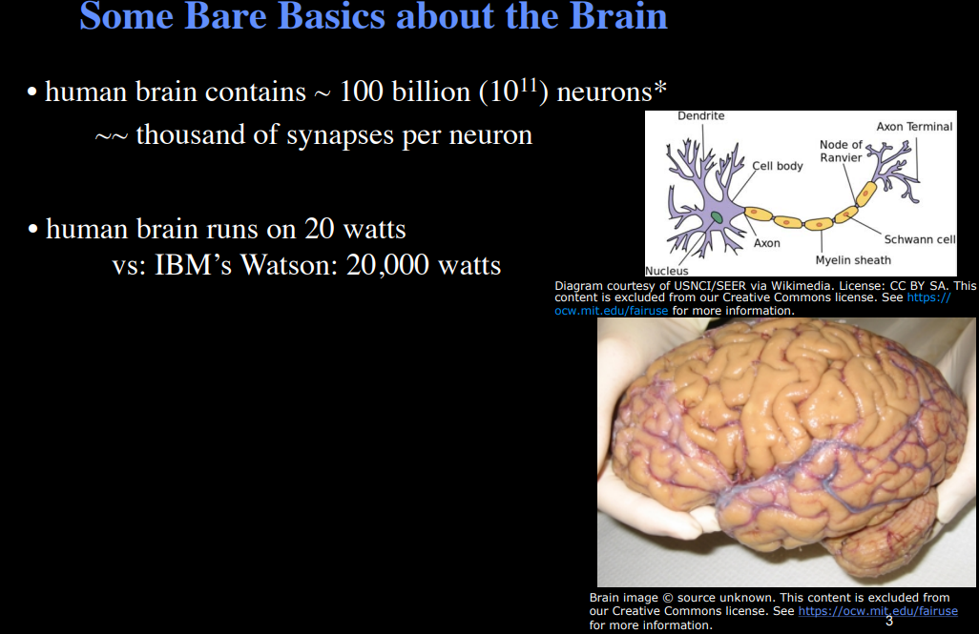
Brain is incredibly energetically efficiently

Slide 6
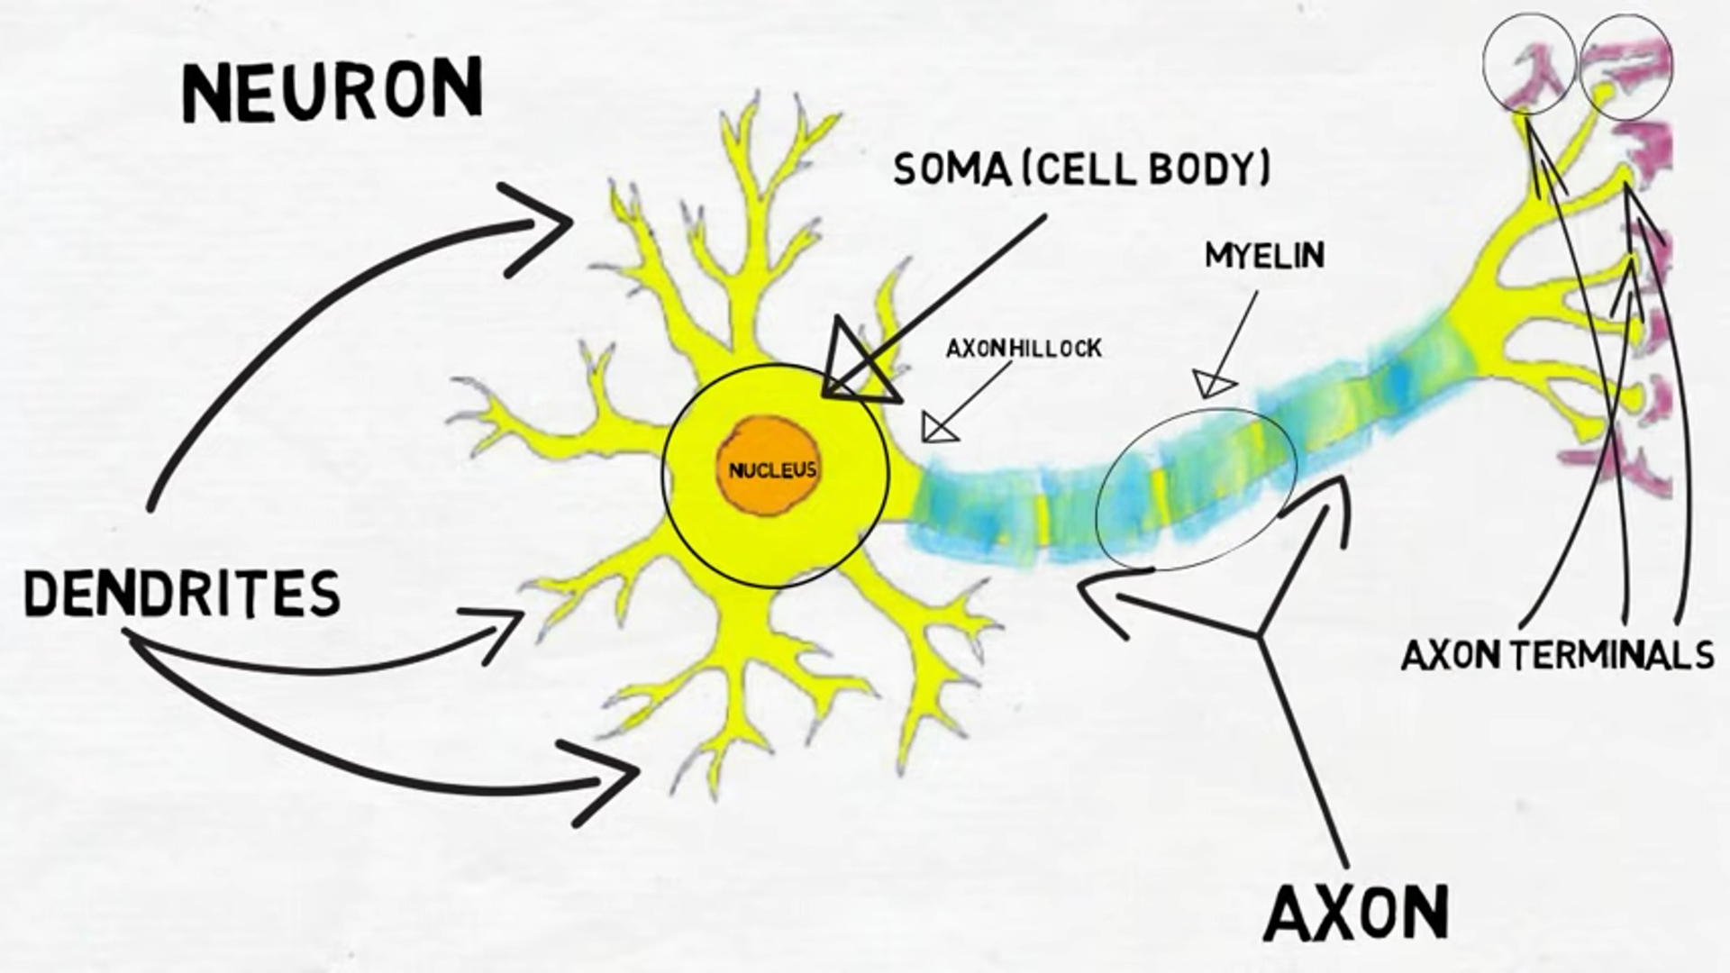

Slide 7
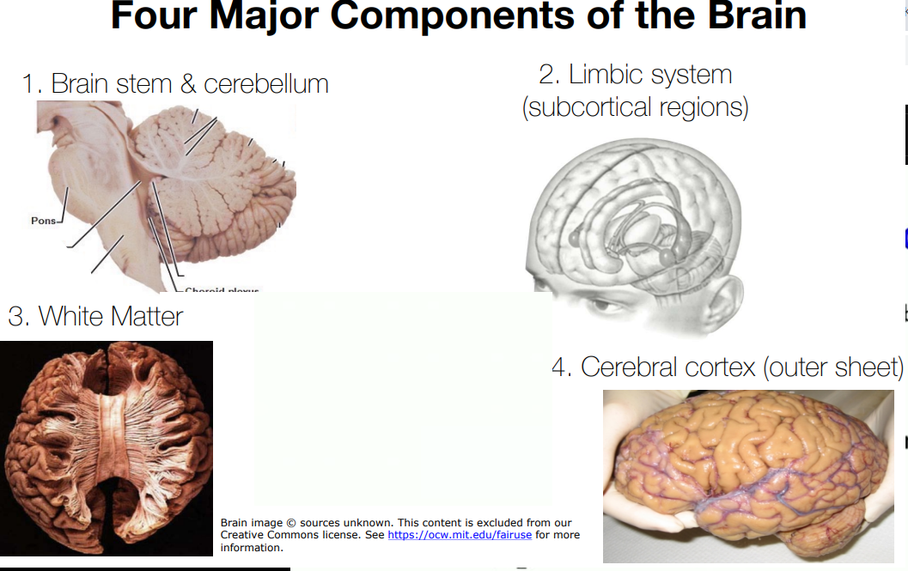

Slide 8
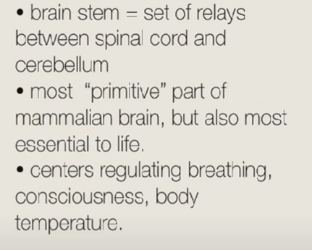
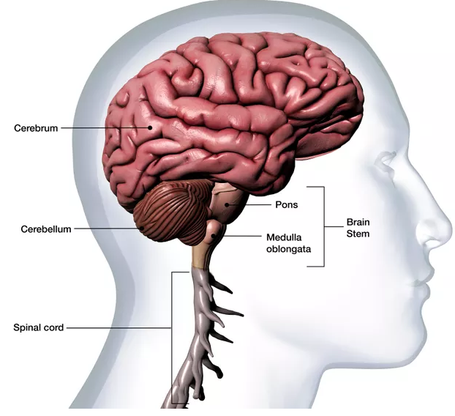
Brain stem & cerebellum
Brain stem relays for the information coming from spinal cord.
And send to Cerebellum.

Slide 9
Brain stem & cerebellum
Cerebellum involves in motor coordination
Role in cognition is unclear

Slide 10
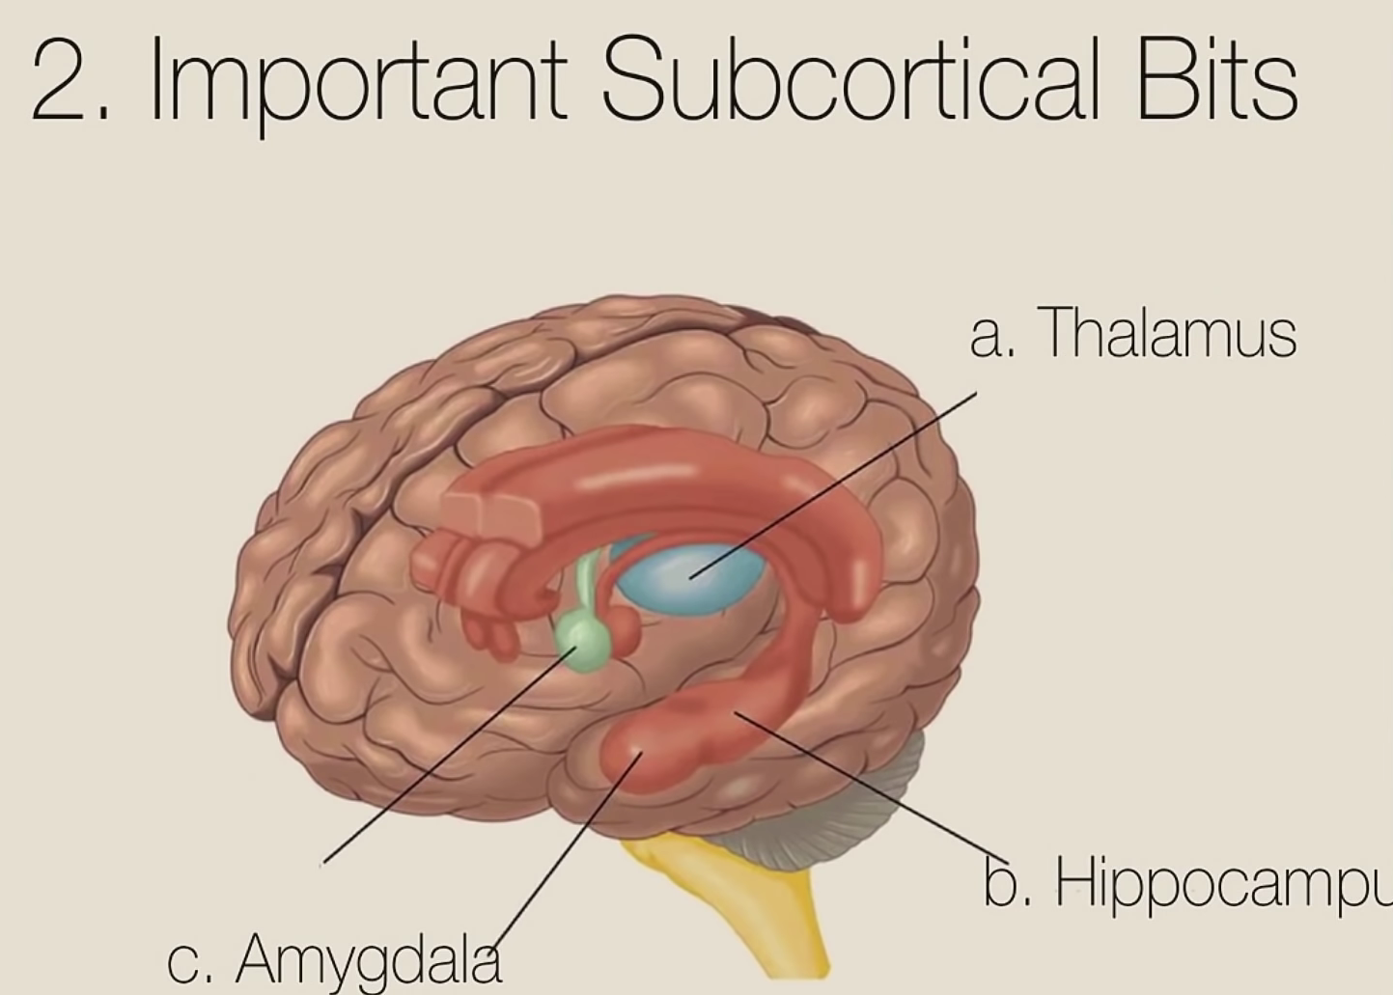

Slide 11
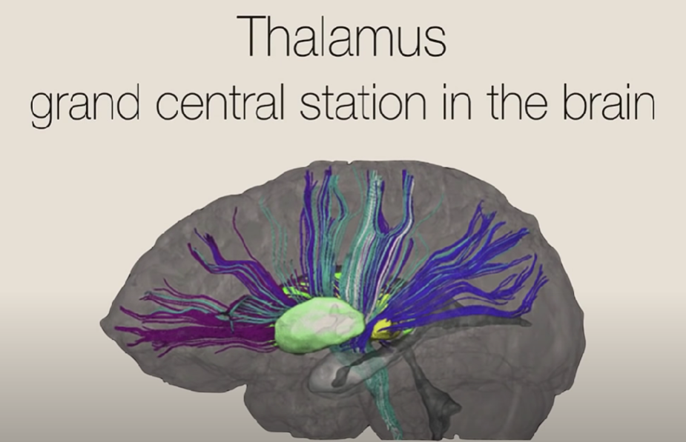

Slide 13
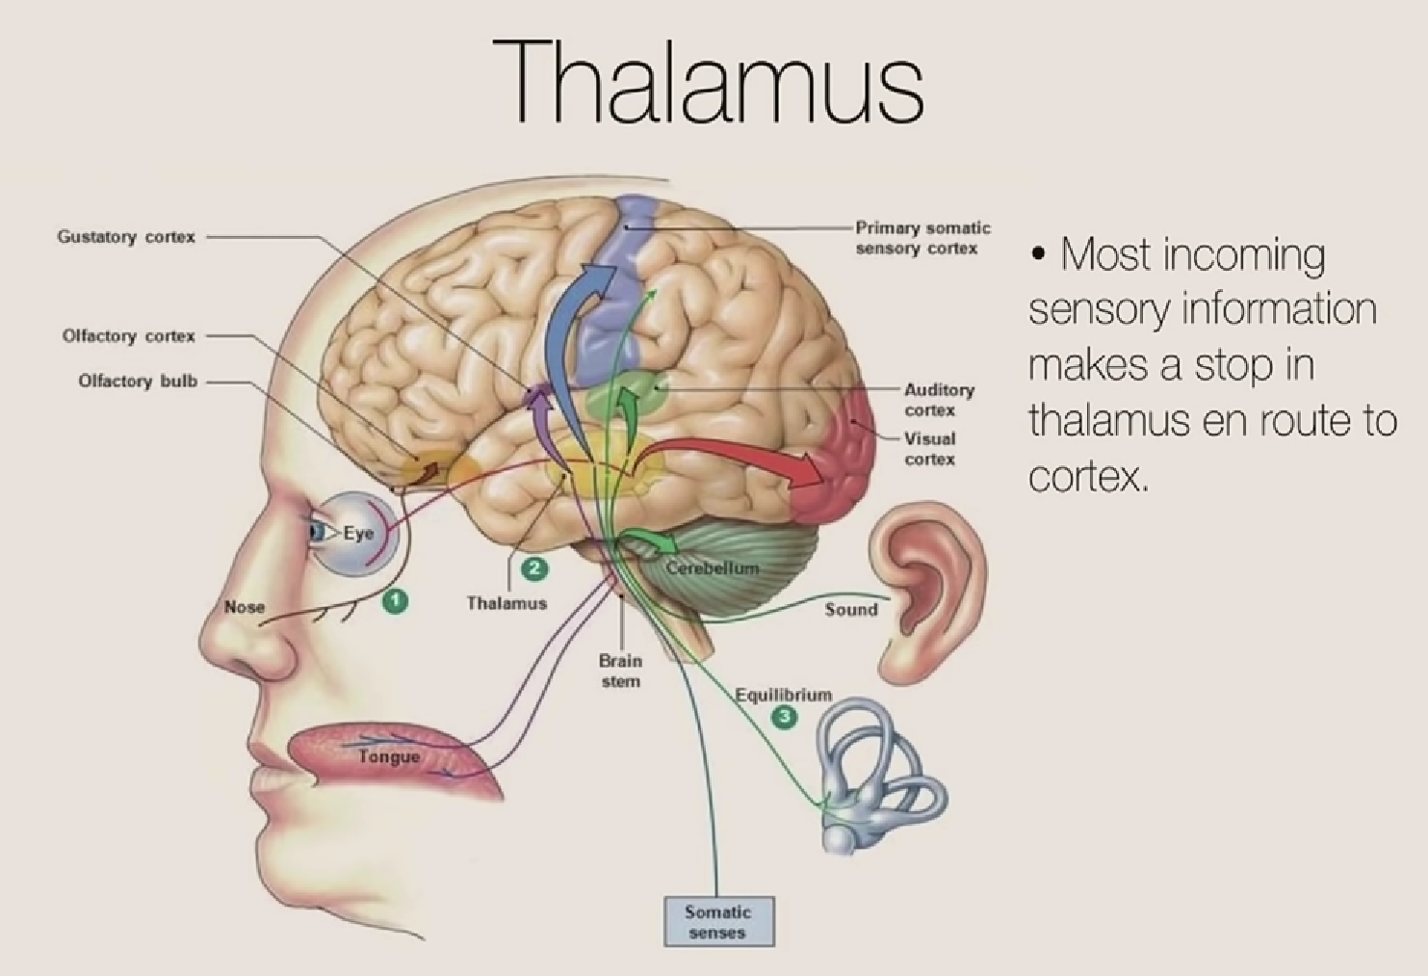

Slide 14
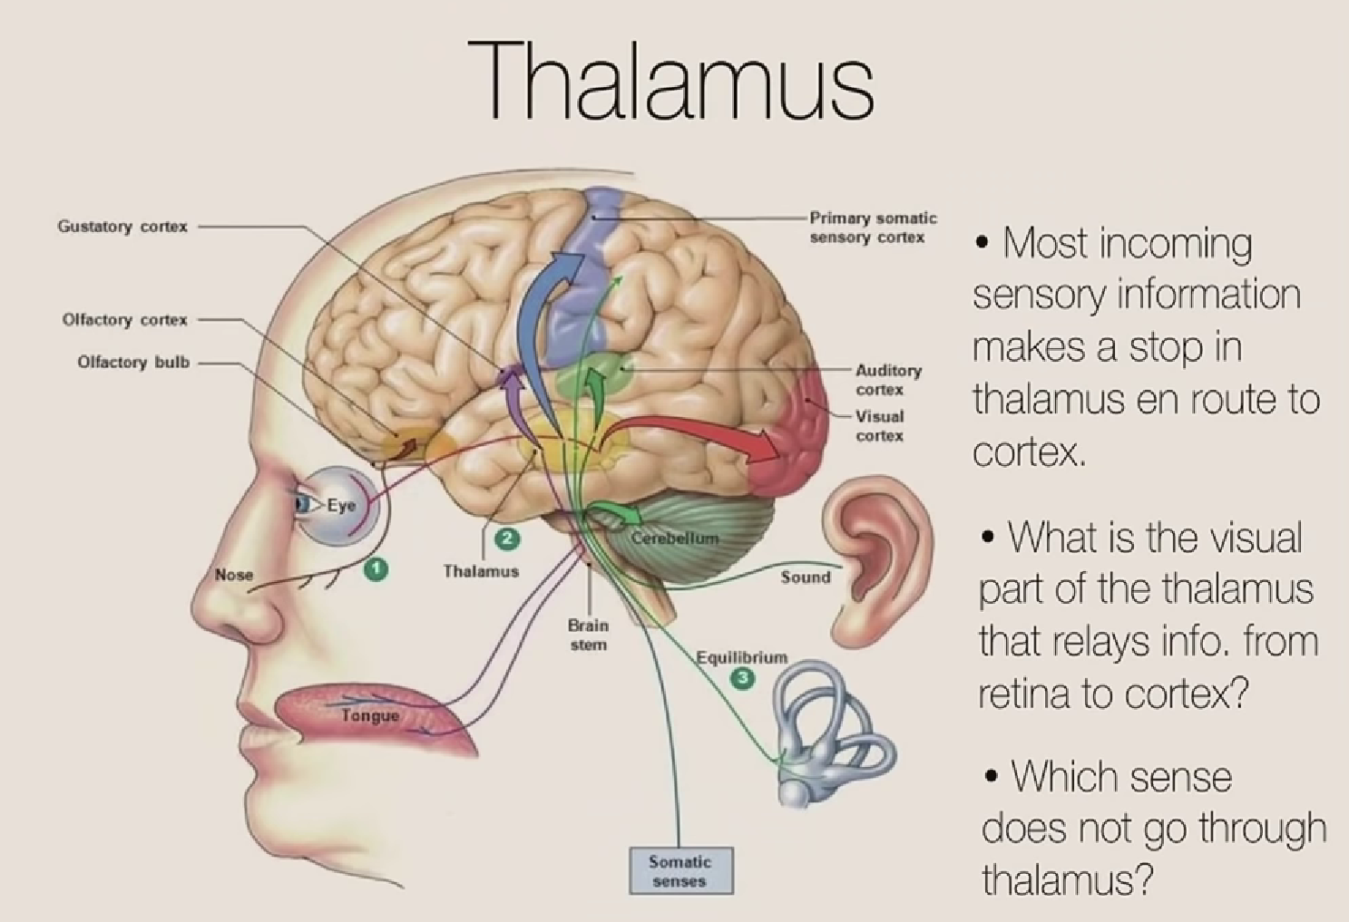

Slide 15
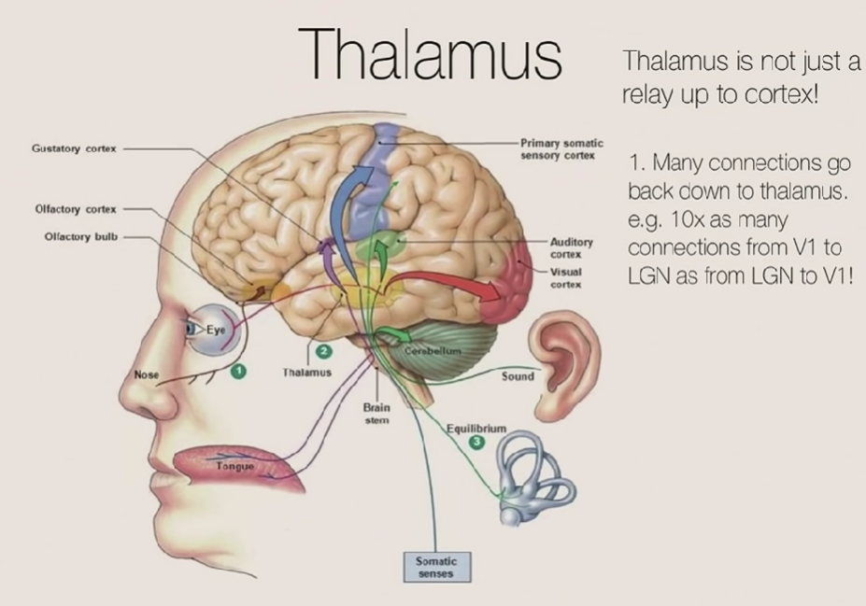

Slide 16
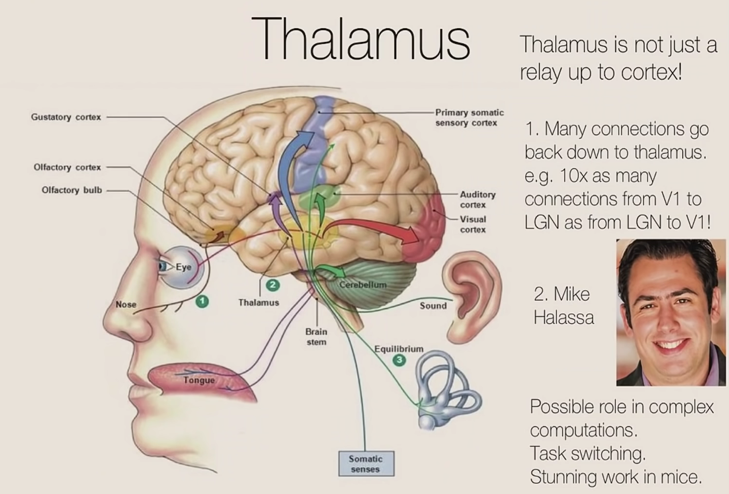
Thalamus involved in high-level cognitive computation in mice.
When mice needs to switch from one task to another, Thalamus plays a key role.

